Slide 1
Graphs
The truth prevails in the end. I will always stand for the truth

Slide 2
Use of Graphs
Car navigation system
Efficient database
Build a bot to retrieve info off WWW
Representing computational models
Many other applications.
This course we focus more on the properties of abstract graphs rather on algorithms.

Slide 3
Graphs
Graphs is special data structure, which we can represent through two sets-
Set of Vertices / Nodes - V
Set of Edges - E
Dhaka
Rajshahi
1
Dilly
DHK
2
Let,
V = {1, 2, 3, 4}
E = {(1,2), (2,3), (1,4)}
Bangkok
NY
Khulna
CTG
3
4

Slide 4
Graphs –Intuitive Notion
A graph is a bunch of vertices (or nodes) represented by circles which are connected by edges, represented by line segments

Slide 5
Graphs
Definition
A graph G = (V , E) consists of V, a nonempty set of vertices (or nodes) and E, a set of edges (possibly empty). Each edge has either one or two vertices associated with it, called its end points. An edge is said to connect its endpoints.

Slide 6
Graphs Example
{1,2}
1
2
{1,3}
{2,3}
{2,4}
{3,4}
3
4
{1,4}
SET OF VERTICES
V = { 1, 2, 3, 4 }
SET OF EDGES
E = { (1, 2), (1, 3), (2, 3), (2, 4), (3, 4), (1, 4) }

Slide 7
Simple Graphs Example
Dhaka
Dilly
SET OF VERTICES
SET OF EDGES
Bangkok
NY

Slide 8
Infinite and Finite Graphs
Infinite Graphs
A graph with an infinite vertex set or an infinite number of edges is called an infinite graph.
Finite Graphs
A graph with a finite vertex set and a finite edge set is called a finite graph.

Slide 9
Simple Graphs
Definition
A graph in which each edge connects two different vertices and where
no two edges connect the same pair of vertices is called a simple graph.
Dhaka
Dilly
Bangkok
NY

Slide 10
Multigraphs
Definition
Graphs that may have multiple edges connecting the same vertices are called multigraphs.
Dhaka
Dilly
Bangkok
NY

Slide 11
Pseudographs
Definition
Edges that connect a vertex to itself are called loops. A graph with loop (self-loop) is called pseudograph.
Dhaka
Dilly
Bangkok
NY

Slide 12
Undirected Graphs
Dhaka
Dilly
Bangkok
NY

Slide 13
Directed Graphs
Dhaka to Rajshahi
Dhaka to Chapai
Rajshahi to Dhaka
No Chapai to Dhaka, but Chapai to Rajshahi
Dhaka
Rajshahi
Chapai

Slide 14
A Directed Graph
Definition
A directed graph (or digraph) (V, E) consists of a nonempty set of vertices V and a set of directed edges (or arcs) E. Each directed edge is associated with an ordered pair of vertices. The directed edge associated with the ordered pair (u, v) is said to start at u and end at v.
The edge (a,b) is also denoted by a →b
a is called the source of the edge while
b is called the target of the edge.

Slide 15
Directed Graphs
Simple Directed Graphs
Multiple Directed Graphs
Mixed Graphs

Slide 16
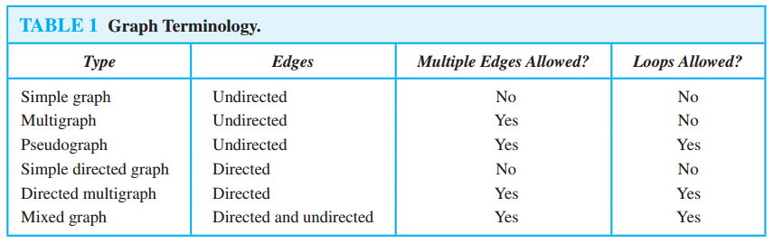
Types of Graphs

Slide 17
Undirected Graphs: Adjacent
Definition
Vertices are adjacent if they are the endpoints of the same edge or they are connected by the same edge.
1
2
Adjacent of 1 :
2 and 4
Adjacent of 2 :
1 and 3
Adjacent of 3 :
2
3
4

Slide 18
Undirected Graphs Terminology
Adjacent Vertices (Neighbors)
Definition 1. Two vertices, u and v in an undirected graph G are called adjacent (or neighbors) in G, if {u, v} is an edge of G.
An edge e connecting u and v is called incident with vertices u and v, or is said to connect u and v. The vertices u and v are called endpoints of edge {u, v}.

Slide 19
Undirected Graphs
Terminology
e₁
A: 1 is adjacent to 2 and 3
2 is adjacent to 1 and 3
3 is adjacent to 1 and 2
4 is not adjacent to any vertex
1
e₂
2
e₃
e₄
e₅
e₆
3
4

Slide 20
Undirected Graphs Terminology
A vertex is incident with an edge (and the edge is incident with the vertex) if it is the endpoint of the edge.
Q: Which edges are incident to 1? How about incident to 2, 3, and 4?
e₁
1
e₂
2
e₃
e₄
e₅
e₆
3
4

Slide 21
Undirected Graphs Terminology
e₁
A: e₁, e₂, e₃, e₆ are incident with 1
2 is incident with e₁, e₂, e₄, e₅, e₆
3 is incident with e₃, e₄, e₅
4 is not incident with any edge
1
e₂
2
e₃
e₄
e₅
e₆
3
4

Slide 22
Undirected Graphs: Degree
Definition
The degree of a vertex in an undirected graph is the number of edges incident with it, except that a loop at a vertex contributes twice to the degree of that vertex. The degree of the vertex v is denoted by deg(v).
1
2
deg (1) :
2
deg (3) :
1
deg (4) :
3
3
4

Slide 23
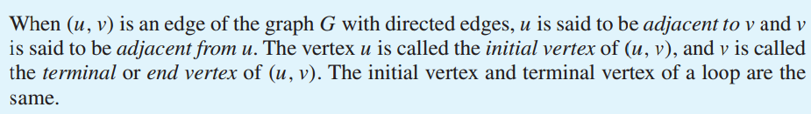
Directed Graphs : Adjacent
Definition
1
2
Adjacent of 1 :
2 and 4
Adjacent of 2 :
1 and 3
Adjacent of 3 :
2
3
4

Slide 24
Directed Graphs : Degree
1
2
In degree :
Out degree:
3
4

Slide 25
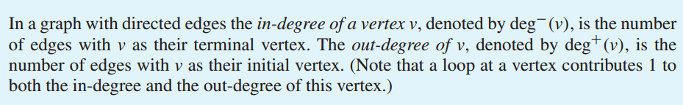
Directed Graphs : Degree
Definition

Slide 26
Oriented Degree when Edges Directed
The in-degree of a vertex (deg⁻) counts the number of edges that stick in to the vertex.
The out-degree (deg⁺) counts the number sticking out.
Q: What are in-degrees and out-degrees of all the vertices?
2
1
3

Slide 27
Oriented Degree when Edges Directed
A: deg⁻(1) = 0
deg⁻(2) = 3
deg⁻(3) = 4
deg⁺(1) = 2
deg⁺(2) = 3
deg⁺(3) = 2
2
1
3

Slide 28
Some Special Simple Graphs : Complete Graphs - Kn
Complete Graphs - K_{n}
A complete graph on n vertices, denoted by K_{n}, is a simple graph that contains exactly one edge between each pair of distinct vertices.
No. of Edges = n(n-1) / 2

Slide 29
Graph Patterns Complete Graphs - Kn
Complete Graphs – K_{n ,} when n = 1, 2, 3, 4, 5
K₁ K₂ K₃ K₄ K₅

Slide 30
Some Special Simple Graphs : Cycles - Cn
Cycles - C_{n}
A cycle C_{n}, n ≥ 3, consists of n vertices v₁, v₂, ….., v_{n} and edges {v₁, v₂},
{v₂, v₃}, ..., {v_{n}−1, v_{n}}, and {v_{n}, v₁}.
That is, vertex i is connected to i +1 mod n and to i -1 mod n vertex.
No. of Edges = n

Slide 31
Graph Patterns Cycles - Cn
Q: What type of graph are C₁ and C₂ ?
C₁ C₂ C₃ C₄ C₅
A: Pseudographs

Slide 32
Some Special Simple Graphs : Wheel Graph
Wheel Graph
We obtain a wheel W_{n} when we add an additional vertex to a cycle C_{n}, for n ≥ 3, and connect this new vertex to each of then vertices in C_{n}, by new edges.

Slide 33
Graph Patterns Wheels - Wn
W_{n ;} n = 3, 4, 5
W₃ W₄ W₅
.

Slide 34
Some Special Simple Graphs : Cubes - Qn
Cubes - Q_{n}
Q₀ Q₁ Q₂ Q₃ Q₄ (hypercube)
The n-cube Q_{n} is defined recursively. Q₀ is just a vertex. Q_{n+1} is gotten by taking 2 copies of Q_{n} and joining each vertex v of Q_{n} with its copy v’ :

Slide 35
Some Special Simple Graphs
Cubes - Q_{n}
Q₀ Q₁ Q₂ Q₃ Q₄ (hypercube)
The n-cube Q_{n} is defined recursively. Q₀ is just a vertex. Q_{n+1} is gotten by taking 2 copies of Q_{n} and joining each vertex v of Q_{n} with its copy v’ :

Slide 36
Some Special Simple Graphs
Cubes - Q_{n}
Q₀ Q₁ Q₂ Q₃ Q₄ (hypercube)
The n-cube Q_{n} is defined recursively. Q₀ is just a vertex. Q_{n+1} is gotten by taking 2 copies of Q_{n} and joining each vertex v of Q_{n} with its copy v’ :

Slide 37
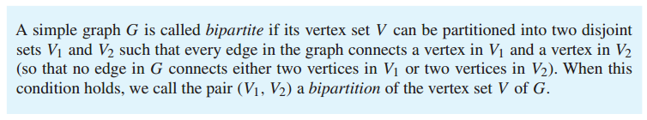
Bipartite Graphs
Definition

Slide 38
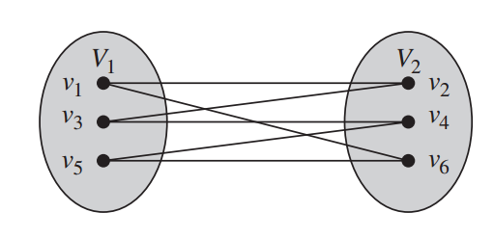
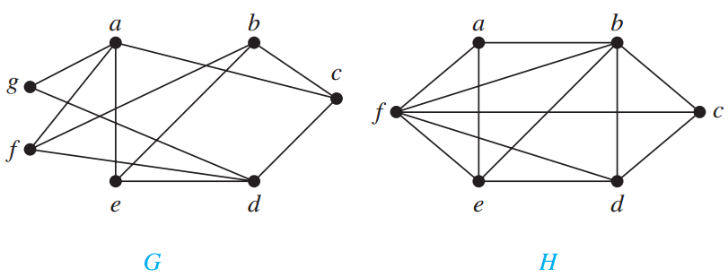
Is Bipartite Graphs?
Notes:
G bipartite, because v1(a,b,d) and v2(g,f,e,c) H is not

Slide 39

Bipartite Graphs
Another definition

Slide 40
EG: C₄ is a bichromatic:
And so is bipartite, if we redraw it:

Slide 41
EG: C₄ is a bichromatic:
And so is bipartite, if we redraw it:

Slide 42
EG: C₄ is a bichromatic:
And so is bipartite, if we redraw it:

Slide 43
EG: C₄ is a bichromatic:
And so is bipartite, if we redraw it:

Slide 44
EG: C₄ is a bichromatic:
And so is bipartite, if we redraw it:

Slide 45
Bipartite Graphs
EG: C₄ is a bichromatic:
And so is bipartite, if we redraw it:

Slide 46
EG: C₄ is a bichromatic:
And so is bipartite, if we redraw it:

Slide 47
EG: C₄ is a bichromatic:
And so is bipartite, if we redraw it:

Slide 48
Bipartite Graphs
EG: C₄ is a bichromatic:
And so is bipartite, if we redraw it:

Slide 49
EG: C₄ is a bichromatic:
And so is bipartite, if we redraw it:

Slide 50
EG: C₄ is a bichromatic:
And so is bipartite, if we redraw it:

Slide 51
EG: C₄ is a bichromatic:
And so is bipartite, if we redraw it:
Q: For which n is C_{n} bipartite?

Slide 52
Is Bipartite Graphs?
Notes:
G bipartite, because v1(a,b,d) and v2(g,f,e,c) H is not

Slide 53
Bipartite Graphs
A: C_{n} is bipartite when n is even. For even n color all odd numbers red and all even numbers green so that vertices are only adjacent to opposite color.
If n is odd, C_{n} is not bipartite. If it were, color 0 red. So 1 must be green, and 2 must be red. This way, all even numbers must be red, including vertex n-1. But n-1 connects to 0 →←.

Slide 54
Graph Patterns Complete Bipartite - Km,n
When all possible edges exist in a simple bipartite graph with m red vertices and n green vertices, the graph is called complete bipartite and the notation K_{m,n} is used. EG:
K_{2,3} K_{4,5}

Slide 55
Degree of a vertex
Definition 1. The degree of a vertex in an undirected graph is the number of edges incident with it, except that a loop at a vertex contributes twice to the degree of that vertex.
c
d
deg( d ) = 1
b
a
g
f
e

Slide 56
Degree of a vertex
Degree of a vertex
Definition 1. The degree of a vertex in an undirected graph is the number of edges incident with it, except that a loop at a vertex contributes twice to the degree of that vertex.
c
d
b
deg( e ) = 0
a
g
f
e

Slide 57
Degree of a vertex
Degree of a vertex
Definition 1. The degree of a vertex in an undirected graph is the number of edges incident with it, except that a loop at a vertex contributes twice to the degree of that vertex.
c
d
deg( b ) = 6
b
a
g
f
e

Slide 58
Degree of a vertex
Degree of a vertex
Find the degree of all the other vertices.
deg( a ) deg( c ) deg( f ) deg( g )
c
d
deg( b ) = 6
deg( d ) = 1
b
deg( e ) = 0
a
g
f
e

Slide 59
Degree of a vertex
Degree of a vertex
Find the degree of all the other vertices.
deg( a ) = 2 deg( c ) = 4 deg( f ) = 3 deg( g ) = 4
c
d
deg( b ) = 6
deg( d ) = 1
b
deg( e ) = 0
a
g
f
e

Slide 60
Degree of a vertex
Degree of a vertex
Find the degree of all the other vertices.
deg( a ) = 2 deg( c ) = 4 deg( f ) = 3 deg( g ) = 4
TOTAL of degrees = 2 + 4 + 3 + 4 + 6 + 1 + 0 = 20
c
d
deg( b ) = 6
deg( d ) = 1
b
deg( e ) = 0
a
g
f
e

Slide 61
Degree of a vertex
Degree of a vertex
Find the degree of all the other vertices.
deg( a ) = 2 deg( c ) = 4 deg( f ) = 3 deg( g ) = 4
TOTAL of degrees = 2 + 4 + 3 + 4 + 6 + 1 + 0 = 20
TOTAL NUMBER OF EDGES = 10
c
d
deg( b ) = 6
deg( d ) = 1
b
deg( e ) = 0
a
g
f
e

Slide 62
Handshaking Theorem
Theorem 1. Let G = (V, E) be an undirected graph G with e edges. Then
∑ deg( v ) = 2 e
v ε V
“The sum of the degrees over all the vertices equals twice the number of edges.”
NOTE: This applies even if multiple edges and loops are present.

Slide 63
Adjacency Matrix
A simple graph G = (V, E) with n vertices
can be represented by its adjacency matrix,
A, where entry a_{ij} in row i and column j is
1 if { v_{i}, v_{j} } is an edge in G,
a_{ij} =
0 otherwise.

Slide 64
Finding the adjacency matrix
c
c
This graph has 6 vertices a, b, c, d, e, f. We can arrange them in that order.
b
d
f
a
a
e
e
W₅

Slide 65
Finding the adjacency matrix
Finding the adjacency matrix
TO
a b c d e f
c
c
FROM
a 0 1 0 0 1 1
b
c
d
e
f
b
d
f
a
a
e
e
W₅
There are edges from a to b, from a to e, and from a to f

Slide 66
Finding the adjacency matrix
Finding the adjacency matrix
TO
a b c d e f
c
c
FROM
a 0 1 0 0 1 1
b 1 0 1 0 0 1
c
d
e
f
b
d
f
a
a
e
e
W₅
There are edges from b to a, from b to c, and from b to f

Slide 67
Finding the adjacency matrix
Finding the adjacency matrix
TO
a b c d e f
c
c
FROM
a 0 1 0 0 1 1
b 1 0 1 0 0 1
c 0 1 0 1 0 1
d
e
f
b
d
f
a
a
e
e
W₅
There are edges from c to b, from c to d, and from c to f

Slide 68
Finding the adjacency matrix
Finding the adjacency matrix
TO
a b c d e f
c
c
FROM
a 0 1 0 0 1 1
b 1 0 1 0 0 1
c 0 1 0 1 0 1
d
e
f
b
d
f
a
a
e
e
W₅
COMPLETE THE ADJACENCY MATRIX . . .

Slide 69
Finding the adjacency matrix
Finding the adjacency matrix
TO
a b c d e f
c
c
FROM
a 0 1 0 0 1 1
b 1 0 1 0 0 1
c 0 1 0 1 0 1
d 0 0 1 0 1 1
e 1 0 0 1 0 1
f 1 1 1 1 1 0
b
d
f
a
a
e
e
W₅
Notice that this matrix is symmetric. That is a_{ij} = a_{ji} Why?

